Slide 1

Expanding the unit of testing in .NEt
Raul Burian

Slide 2
Plan
Levels of testing
Test properties
Levels of testing interpretation today
Expanding unit tests into “component” tests
DEMO
What have we learned
Resources

Slide 3
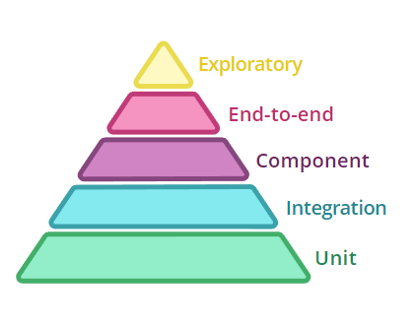
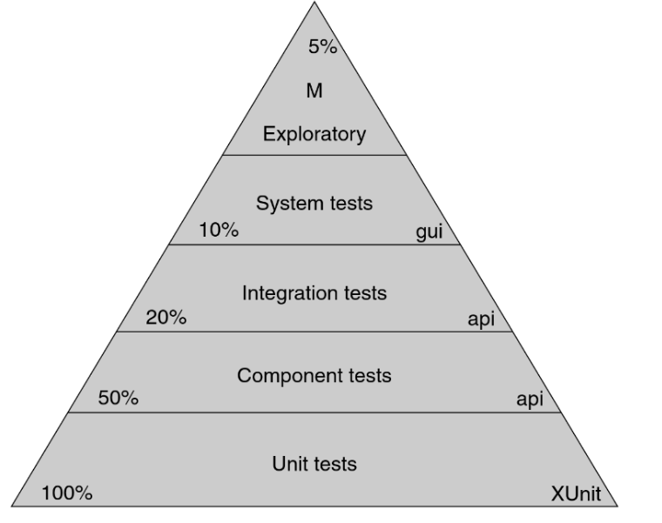
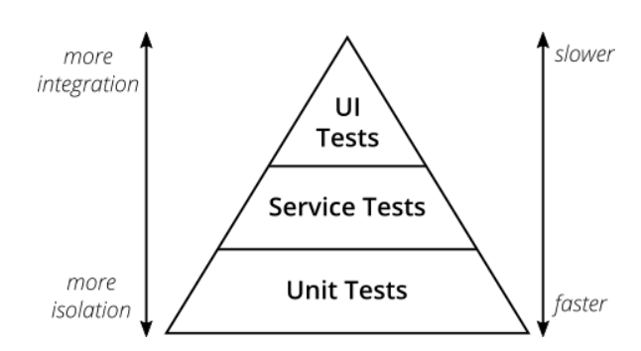
Levels of testing

Slide 4
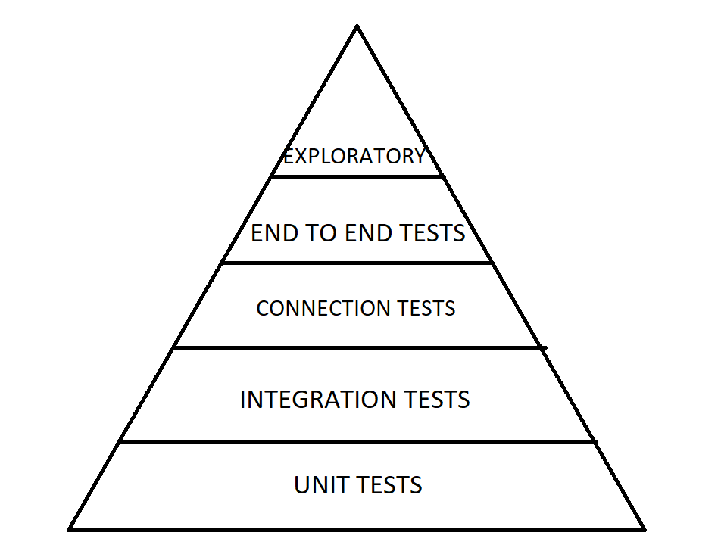
Levels of testing
Unit tests:
Test the smallest piece of the puzzle (usually a class) individually and isolated
Integration tests:
Test multiple integrated pieces in isolation
Connection tests:
Test that the system can connect to other dependent services
End to end tests:
Test your system’s effects upon the output of other systems
Exploratory:
Manual exploration of test situations
Not the focus

Slide 5
Test properties
Isolated and composable
Tests should return the same results regardless of the order in which they are run.
Running 1 or 1000 should have the same outcome
Fast & “Cheap”
Tests should run quickly.
Tests should be cheap to write and maintain
Behavioral
Tests should be sensitive to changes in the behavior of the code under test.
If the behavior changes, the test result should change.
Structure-insensitive
Tests should not change their result if the structure of the code changes.
If the contract holds, there should be no need to change the test
Specific
If a test fails, the cause of the failure should be obvious.
Deterministic
If nothing changes, the test result shouldn’t change.
Always have complete control over a tests outcome
Predictive & Inspiring
Passing the tests should inspire confidence
If the tests pass, then the code under test should be suitable for production.

Slide 6
Test properties – Unit tests (smallest piece of the puzzle)
Isolated and composable
Tests should return the same results regardless of the order in which they are run.
Running 1 or 1000 should have the same outcome
Fast & “Cheap”
Tests should run quickly.
Tests should be cheap to write and maintain
Behavioral
Tests should be sensitive to changes in the behavior of the code under test.
If the behavior changes, the test result should change.
Structure-insensitive
Tests should not change their result if the structure of the code changes.
If the contract holds, there should be no need to change the test
Specific
If a test fails, the cause of the failure should be obvious.
Deterministic
If nothing changes, the test result shouldn’t change.
Always have complete control over a tests outcome
Predictive & Inspiring
Passing the tests should inspire confidence
If the tests pass, then the code under test should be suitable for production.

Slide 7
Test properties – integration tests
Isolated and composable
Tests should return the same results regardless of the order in which they are run.
Running 1 or 1000 should have the same outcome
Fast & “Cheap”
Tests should run quickly.
Tests should be cheap to write and maintain
Behavioral
Tests should be sensitive to changes in the behavior of the code under test.
If the behavior changes, the test result should change.
Structure-insensitive
Tests should not change their result if the structure of the code changes.
If the contract holds, there should be no need to change the test
Specific
If a test fails, the cause of the failure should be obvious.
Deterministic
If nothing changes, the test result shouldn’t change.
Always have complete control over a tests outcome
Predictive & Inspiring
Passing the tests should inspire confidence
If the tests pass, then the code under test should be suitable for production.

Slide 8
Test properties – Connection tests
Isolated and composable
Tests should return the same results regardless of the order in which they are run.
Running 1 or 1000 should have the same outcome
Fast & “Cheap”
Tests should run quickly.
Tests should be cheap to write and maintain
Behavioral
Tests should be sensitive to changes in the behavior of the code under test.
If the behavior changes, the test result should change.
Structure-insensitive
Tests should not change their result if the structure of the code changes.
If the contract holds, there should be no need to change the test
Specific
If a test fails, the cause of the failure should be obvious.
Deterministic
If nothing changes, the test result shouldn’t change.
Always have complete control over a tests outcome
Predictive & Inspiring
Passing the tests should inspire confidence
If the tests pass, then the code under test should be suitable for production.

Slide 9
Test properties – E2E
Isolated and composable
Tests should return the same results regardless of the order in which they are run.
Running 1 or 1000 should have the same outcome
Fast & “Cheap”
Tests should run quickly.
Tests should be cheap to write and maintain
Behavioral
Tests should be sensitive to changes in the behavior of the code under test.
If the behavior changes, the test result should change.
Structure-insensitive
Tests should not change their result if the structure of the code changes.
If the contract holds, there should be no need to change the test
Specific
If a test fails, the cause of the failure should be obvious.
Deterministic
If nothing changes, the test result shouldn’t change.
Always have complete control over a tests outcome
Predictive & Inspiring
Passing the tests should inspire confidence
If the tests pass, then the code under test should be suitable for production.

Slide 10
Can we do better?

Slide 11
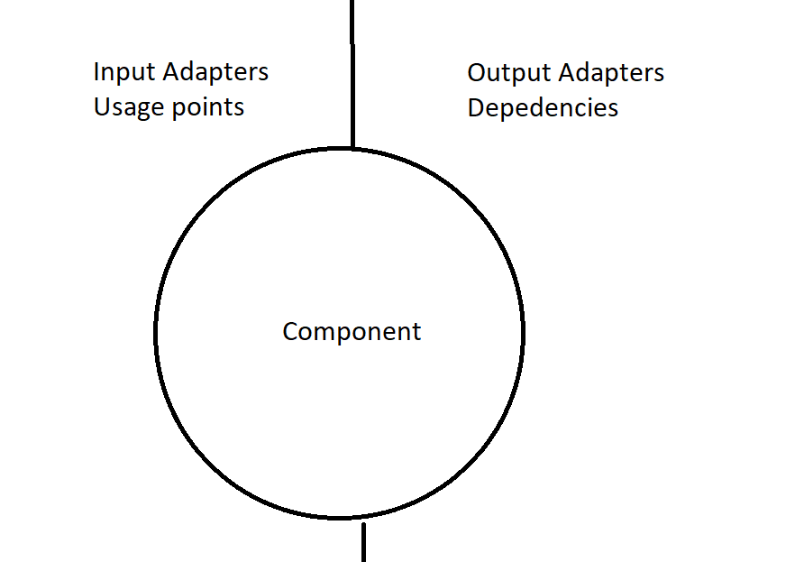
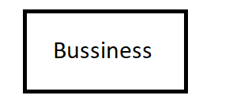
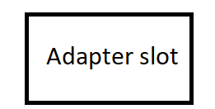


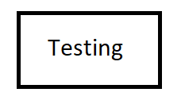

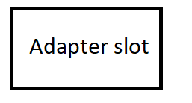

Can we do better?
Component = Entire isolated service ?

Slide 12
Test properties – Component tests – Test an entire service / component in isolation
Isolated and composable
Tests should return the same results regardless of the order in which they are run.
Running 1 or 1000 should have the same outcome
Fast & “Cheap” – not as fast but still pretty fast
Tests should run quickly.
Tests should be cheap to write and maintain
Behavioral
Tests should be sensitive to changes in the behavior of the code under test.
If the behavior changes, the test result should change.
Structure-insensitive - mpstly
Tests should not change their result if the structure of the code changes.
If the contract holds, there should be no need to change the test
Specific
If a test fails, the cause of the failure should be obvious.
Deterministic
If nothing changes, the test result shouldn’t change.
Always have complete control over a tests outcome
Predictive & Inspiring
Passing the tests should inspire confidence
If the tests pass, then the code under test should be suitable for production.

Slide 13
DEMO
DEMO

Slide 14
Refs
Test Properties
Testing in microservices
.NET testing WAF
Testing EF
Test containers
Cosmin Stirbu
https://github.com/RaulBurian/ExpandingUnits

